Slide 1

Practical Arduino
From the Ground Up

Slide 2
Potential Course Outline (assumes no Prior electronics or Arduino knowledge)
Review Design Objectives. What you will learn. What you will need. Primer on Components and Symbols. Conductors, Insulators and Ohms Law. Introduce the kit and the included parts and how to obtain one.
Schematic vs PCB. Start it simple. Work up to this design complete walkthrough. (parts orientation, details, tips and tricks, how to solder, assemble board.) Build up the power supply portion the board. How to test your work with visual inspection and basic electrical testing.
Finish the build. Introduce The Arduino IDE. Use of in built test programs like Blink, Servo etc
More on Arduino IDE and simple program design. Use of serial monitor for debugging. Examples of practical use (Each as a standalone short video)
LED outputs (timing and random light)
Button Inputs (debouncing and controlling program flow)
Infrared detectors (sensor needed)
LDR sensors (LDR needed)
Motor Control (Motor Shield needed)
LCD displays (LCD display needed)

Slide 3
General Requirements
Basis:
An Arduino based hardware and software project that will serve as a learning platform
Finished product would be very useful in a variety of situations on any layout.
Ideally ordered as a complete kit. (PCB, all components, including Arduino NANO (clone))
Detailed instructions suitable for novices. Broken down as ‘build’, ‘test’, ‘learn’.
A series of videos can be made for self paced learning (able to pause, go back, review and check)
PCB design should be flexible in that I/O can be reconfigured without too much fuss. (for example taking the LED’s off board)
No expectation of ‘live sessions’ other than maybe introducing the kit once it is available
4 LED on board via R680
Feature List:
Socketable NANO on a carrier board.
Carrier board itself to have mounting holes.
Flexible input power (AC/DC/DCC)
On board regulation to 5Vdc at NANO 5 Volt input
Header pins aligned with standard servo pinout
On board output driver chip can power small relays or actuators.
On board R680 current limiting resistors
2 board mounted Pushbuttons as DI’s
At least some minimal prototype test area.
Multiple communications options
(not all options may be physically possible on the same build)
AC/DC or DCC powered
2 SERVO via 3pin Header
DCC signal via optocoupler
ULN2803A Output Driver
NANO V3 MCU
RS485 C/MRI
2 Buttons on board
CAN Bus
4 Sensors via 3 pin header
I2C via A4/A5
Carrier Board

Slide 4
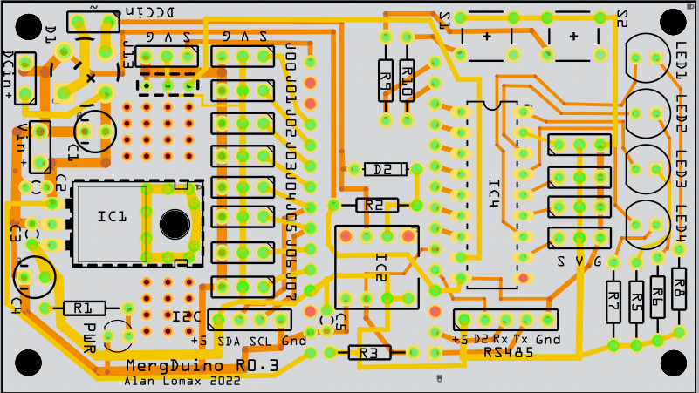
Introducing: MERGduino

Slide 5
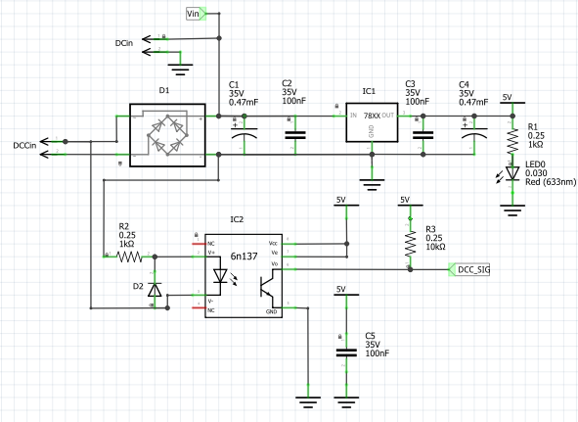
MERGduino: Power Supply
Feature List (Power):
Flexible input power (AC / DCC or DC)
On board regulation to 5vdc for NANO 5VDC Input
Can be built standalone as just a ‘power supply’ providing 5 volts.
Lots of header pin positions can be used for power take off.
On board LED for troubleshooting without NANO
Feature List (DCC Opto-Coupler):
Optional if installed - Optically couples DCC onto to Arduino Pin D3
Enables Arduino to act as a stationary Accessory decoder
Optional – Can omit if not needed. If it is used board must have an
Installed under the NANO to save PCB space.

Slide 6
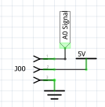

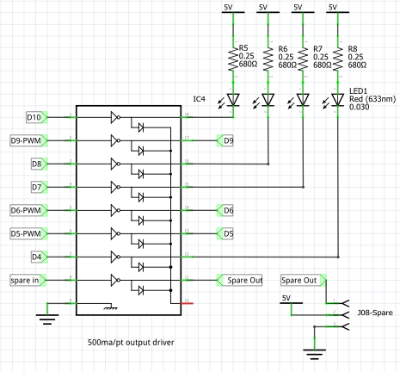
MERGduino: I/O
Left
Standard I/O header with pins in order (Signal, 5VDC, Gnd)
Suitable for Servos and many types of sensors.
Suitable for AI, AO, DI, DO with or without internal pullup
Middle
Two on Board buttons for testing or getting user input.
(use with internal pullup).
Also Includes current limiting resistor in case the pin is accidentally configured for output and then the button is pushed
Bottom
LN2903 output driver.
If not used jumpers can easily be installed directly across.
If included allows a sinking current of 500 ma per pin. Can power small relays, incandescent bulbs, light strips.
4 on board LED’s with current limiting resistors for experimenting.
LED’s could be remote mounted as signals, building lighting, mimic panel
PWM pins available for driving motor shields. (or others)
Spare driver has in/out connection points available

Slide 7
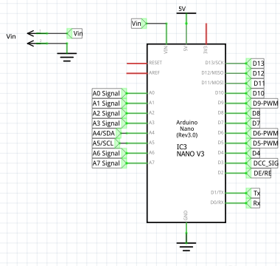
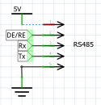
MERGduino: CPU
Standard NANO V3 Clone
To be mounted in header pins which are soldered onto the main board
optoisolator and other small components will be under the NANO
All I/O pins land somewhere and are available
PWM pins called out especially for use on SERVO’s or Motor control
I2C brought out to 4 pin header for connection to servo expander
Tx/Rx available on 5 pin header (with +5 Gnd and a 3rd digital pin so this is suitable for wide range of coms oriented hat connections. (RS485 / CBUS etc)

Slide 8
MERGduino: Work Phases
All Projects go through phases (whether they are recognized as such or not)
Phase | Description | Conditions for Going Forward | Decision | When
0 | Idea | Someone is willing to work it | Yes – Alan | Dec 2021
1 | Definition | Requirements are set. | Yes – Alan | Jan 2022
2 | Basic Design | Schematic Laid out | Yes – Alan | Jan 2022
3 | Detailed Design | PCB Laid Out Design Review Map against requirements
4 | Execution | Previous stage passed. | Get protos built.
5 | Commissioning | Previous stage passed.
6 | Closeout | Considered ‘done’ and ready for use.
Implied is that in all cases a phase can only happen if someone is willing to work that phase (Obviously some resources/effort will be needed). As MERG is a volunteer organization this could be an individual or a ‘working group’.

Slide 9
MERGduino: issues and outcomes
Item | Description | Reasons Why | Reasons Why NOT | Decision | When
0 | Use 5 VDC Power to Arduino instead of Vin | Using a 7805 gives more flexible input power options including standard 9 volt battery and 12 VDC. Offloads the NANO regulator | Reference design used a 7812 | 7805 | Jan 2022
1 | Keep Line Driver IC | Allows higher current loads of independent voltages. Protects NANO | Cost in terms of PCB space Part cost (pennies) | Keep | Jan 2022
2 | Choice of Current Limiting R value | R330 and R470 was traditional | New LED’s more efficient use R680 or even R1K | R680 | Jan 2022
3 | External I2C pullup | Allows control over I2C value Simple soldering job and use of DMM lessons. Ohms Law. | Could use internal pullups Save real estate and cost (pennies) | Internal | Jan 2022
4 | Include MAX485 | Comms/RS485/CMRI connectivity | Cost in terms of PCB space Part cost (pennies) | No (but header available) | Jan 2022
5 | Include MP3 dfPlayer | Sound Fx is another area of interest. | Cost in terms of PCB space Part cost (pennies) | No (but header available) | Jan 2022

